Slide 1

Arabic Text Summarizer

Slide 2

Team Members
Abd El-Rhman Mohey mohammed
Ahmed Adel Draz
Abd El-Rhman Mohammed Nabil
Fady Yousry Adeb
Bavly Gerorge Micheal Nawar

Slide 3
Outline
Intro
Motivation
Define the Problem
Data preprocessing
techniques
Extractive
Abstractive
T5 — Text-To-Text Transfer Transformer
Datasets
Evaluation
Limitations
Demo

Slide 4
Text Summarization?
Text summarization in NLP is the process of summarizing the information in large texts for quicker consumption. In this article, I will walk you through the traditional extractive as well as the advanced generative methods to implement Text Summarization in Python.* .

Slide 5
Motivation
Technology
Arabic

Slide 6
Technology
People keep up with the world affairs by listening to news bites.
People base investment decisions on stock market updates.
With summaries, People can make effective decisions in less time
The motivation Here is to build such tool which is
computationally efficient and creates summaries
automatically.

Slide 7
Advanced topics
Search engine hits
Query-focused summaries enable users to find more relevant documents more accurately, with less need to consult the full text documents more accurately, with less need to consult the full text of the document.

Slide 8
Arabic why?
world focus all about English Text summarization as it is the most common
so available tools on Arabic language specially is counted so finding or implementing tools and getting them to build our model was a challenge
Also means there is a lot of tools in the English models that might work well but needs more enhancing and more data to be developed in Arabic

Slide 9
benchmarking
That’s why we decided to go throw multiple technologies and implement them in Arabic and benchmarking approaches
Background approach lex rank, text rank and new approach based on transformers

Slide 10

The problem

Slide 11
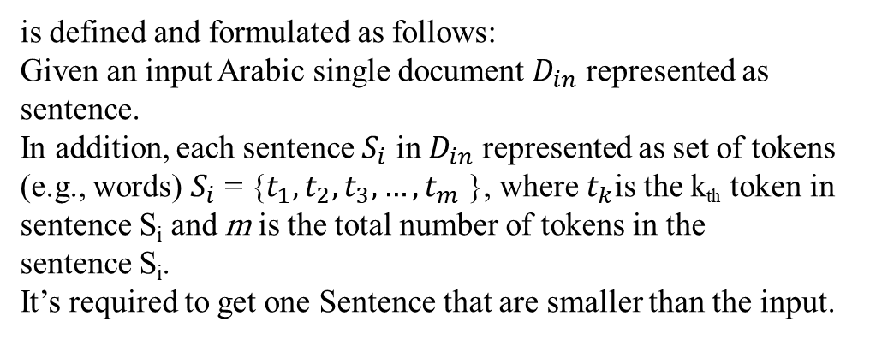
The problem
is defined and formulated as follows:
Given an input Arabic single document $D_{in}$ represented as sentence.
In addition, each sentence $S_{i}$ in $D_{in}$ represented as set of tokens (e.g., words) $S_{i}$ = {$t_{1},t_{2},t_{3},…,t_{m}$ }, where $t_{k}$is the k_{th} token in sentence S_{i} and m is the total number of tokens in the sentence S_{i}.
It’s required to get one Sentence that are smaller than the input.

Slide 12
challenges
Key challenges in text summarization include topic identification, interpretation, summary generation, and evaluation of the generated summary. Most practical text summarization systems are based on some form of extractive summarization.
Abstraction based summarization is inherently more difficult and is an active area of research.

Slide 13
Extraction?
All extraction based summarizers, irrespective of the differences in approaches, perform the following three relatively independent tasks (Nenkova and McKeown, 2011, 2012):
(a) capturing key aspects of text and storing it using an intermediate representation,
(b) scoring sentences in the text based on that representation,
(c) and composing a summary by selecting several sentences.

Slide 14
Other Approaches
The other Approach (abstractive)is to use an existing data set with Din as tall sentence and Dout as smaller one and train Our model to generate new text based on the Text already in Throw the Sentence Din. That might lead to more precise system but not over all good at generalization

Slide 15

Approaches

Slide 16
Background
Traditional :
Extractive models
Deep learning
Abstractive :
Sequence2Sequence
Transformers

Slide 17
Extractive Text Summarization Techniques
Extractive text summarization techniques perform summarization by picking portions of texts and constructing a summary, unlike abstractive techniques which conceptualize a summary and paraphrases it .
Sumy lib
Text Rank
Lex Rank

Slide 18
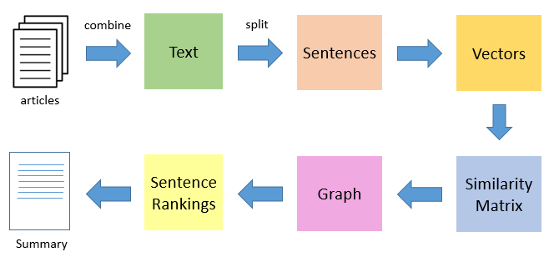
TextRank
TextRank is an extractive and unsupervised text summarization technique.
Then split the text into individual sentences.
In the next step, we will tokenize each sentences to make a list of its words.
Similarities between sentence list of words are then calculated and stored in a similarities matrix.
The similarity matrix is then converted into a graph, with sentences as vertices and similarity scores as edges, for sentence rank calculation.
Finally, a certain number of top-ranked sentences form the final summary.

Slide 19
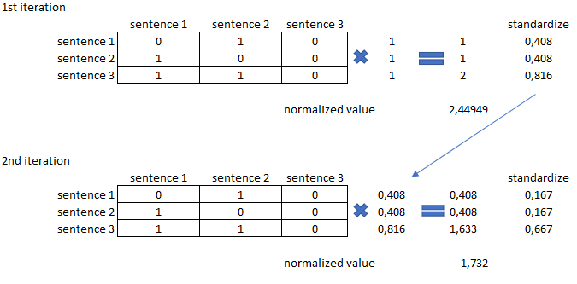
LexRank
The same approach of TextRank taken is lexrank and then we add what is called Eigenvector centrality, to find out the most important sentences LexRank utilizes eigenvector centrality. The method is called power iteration method.

Slide 20
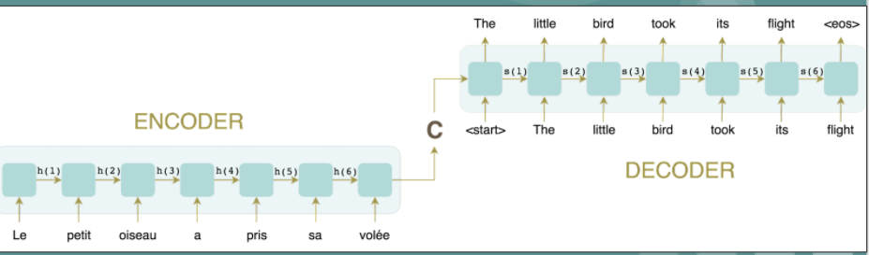
Sequence2Sequence

Slide 21
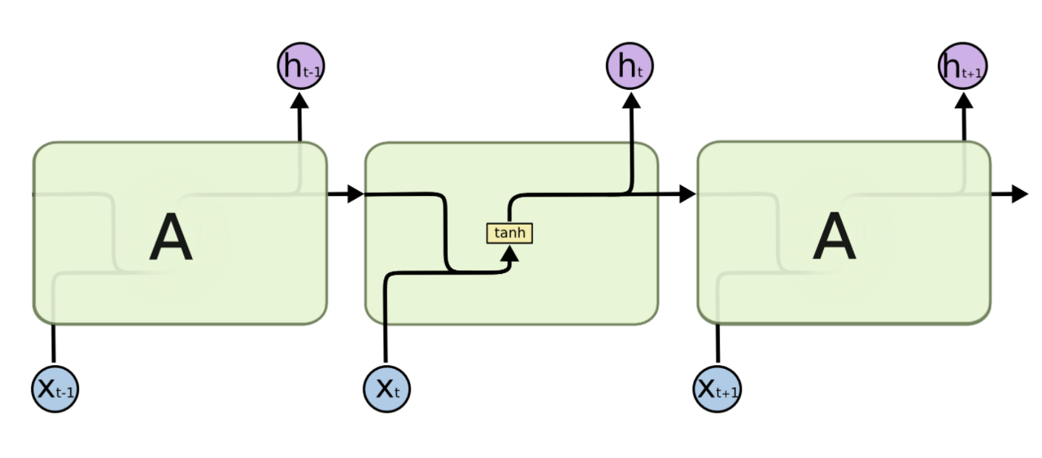
How it works :
1 word per time-step
x(t),h(t-1)
h(t)
y(t)

Slide 22
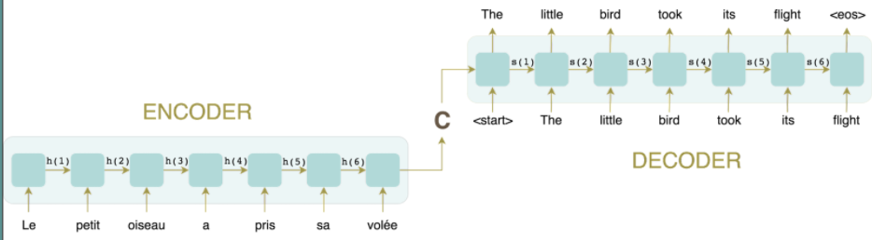
Encoder-Decoder Context vector Decoder operation

Slide 23
problems
Data loss
Time consumption

Slide 24
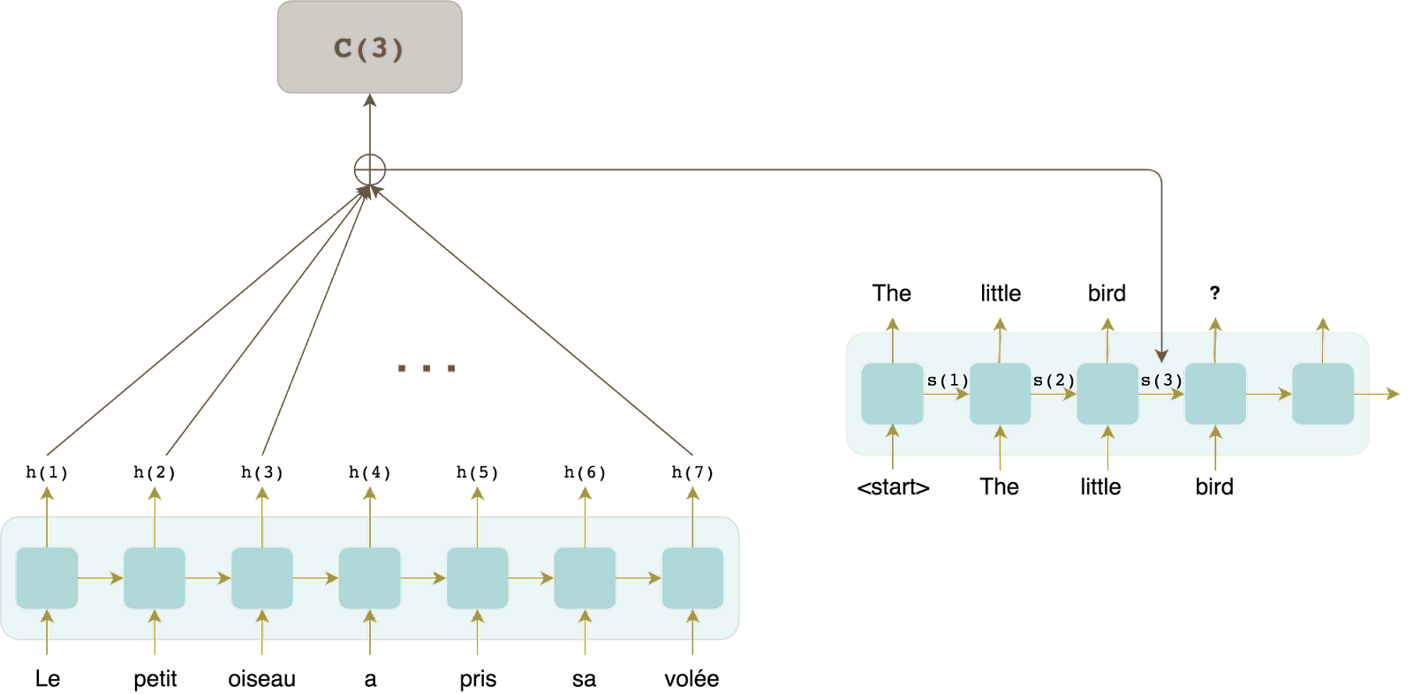
human performance
ATTENTION!!!
Why don’t we try to feed the Decoder all the hidden states
Then:-
Concat
AVG
weight

Slide 25
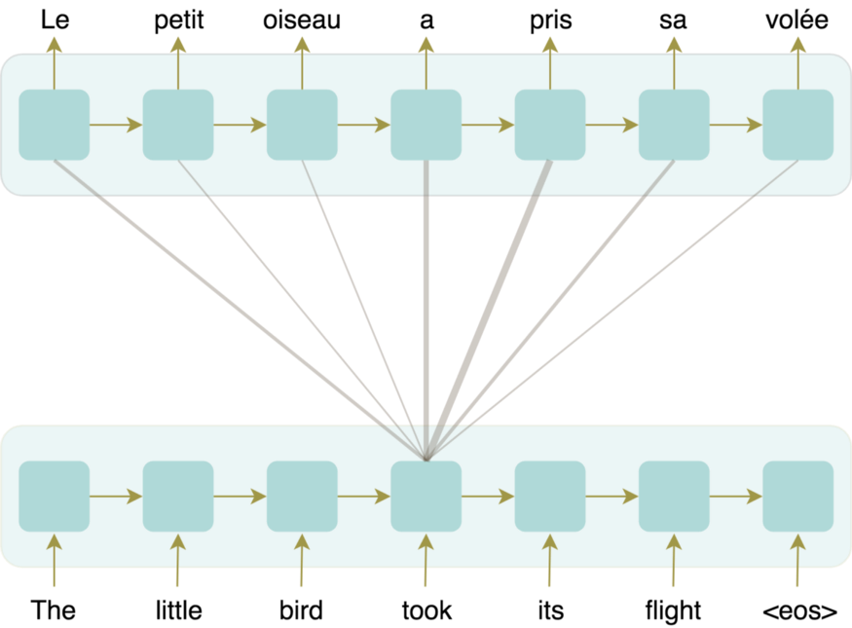
EX:
Additive Attention
Similarity
Softmax
Weight the hidden states

Slide 26
human performance
After Attention using in context vectors
Computing hidden states using Attention
Advantage of the idea

Slide 27
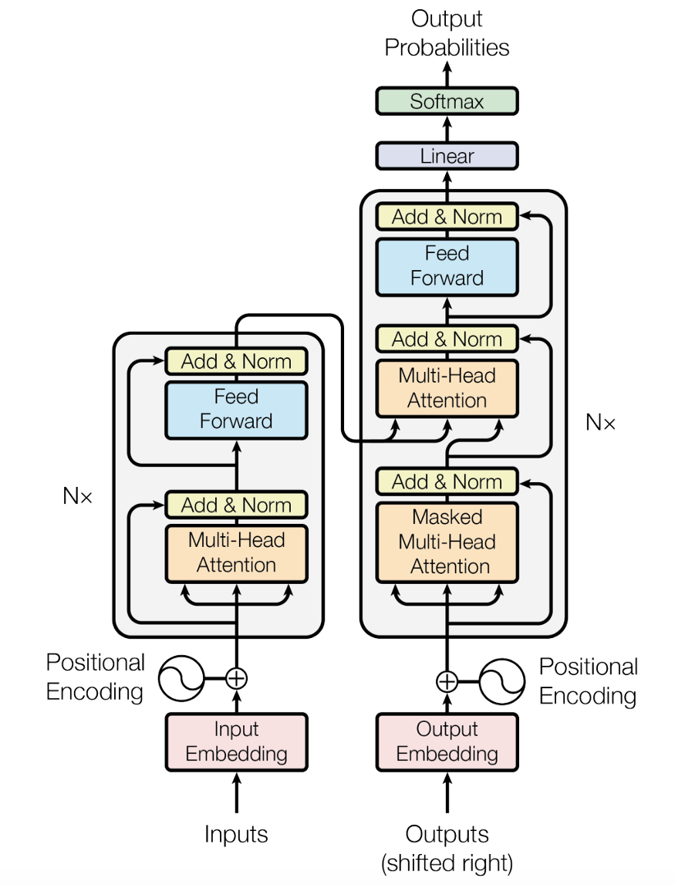
Transformers
Transformers
Self Attention
Multi-Head
Attention
Positional encoding

Slide 28
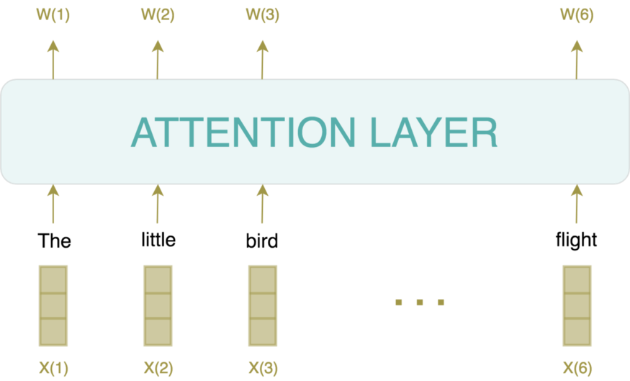
Self Attention
Transforms sequence of tokens into a new sequence of tokens Dot product

Slide 29
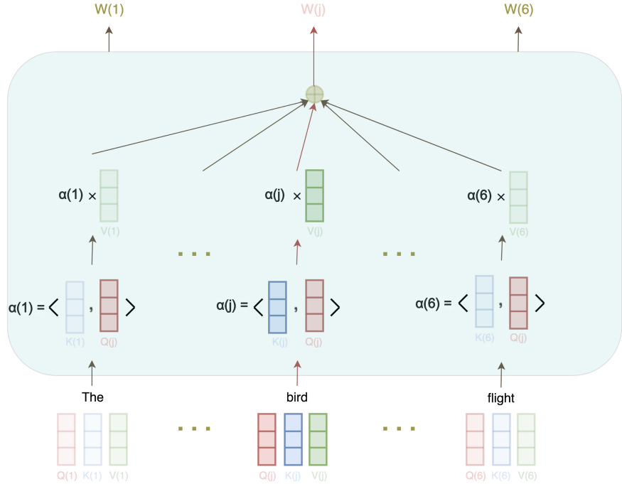
Three Embeddings for the Price of One
Query of needed word
Key of other words
Value is weighted

Slide 30
Multi-Head Attention
Relations between words may vary
Each word has many embeddings by the number of relations that we want the model to realize

Slide 31
T5 — Text-To-Text Transfer Transformer
Released by google in 2020 “Exploring the Limits of Transfer Learning with a Unified Text-to-Text Transformer”
T5 attempts to combine all the downstream tasks into a text-to-text format

Slide 32
T5 — Text-To-Text Transfer Transformer

Slide 33
T5 — Text-To-Text Transfer Transformer
It creates a clean version of the massive common crawl data set called Colossal Cleaned Common crawl(C4). This data set is two orders of magnitude larger than Wikipedia.
It shows that fine tuning on different tasks — summarization, QnA, reading comprehension using the pretrained T5 and the text-text formulation results in state of the art results

Slide 34
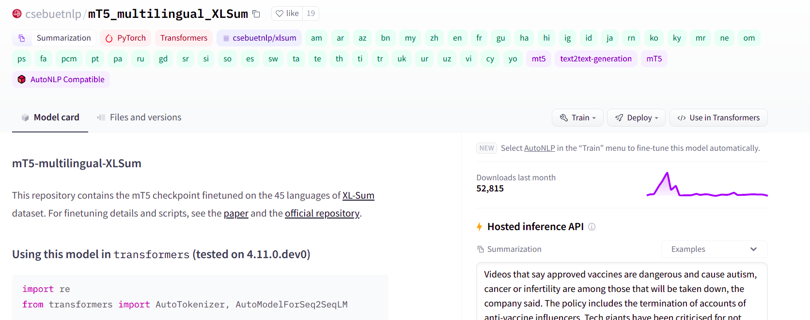
mT5 multilingual XLSum
Trained on XLSum dataset
1.35 million article-summary from BBC
covers 45 languages (include Arabic)
Arabic data size:
Train: 37519
Dev : 4689
Test : 4689

Slide 35


Datasets
Mawdoo3
300,000 records
Article as Text we want to summarize
Headline as summary
Not professional
After cleaning 15,000 records
WikiHow
30,000 records
Better than mawdoo3 dataset
EASC
153 article with 5 summaries each
Human
Expanded the train dataset to 153*5 = 765

Slide 36

Evaluation background

Slide 37
Evaluation
ROUGE
Recall-Oriented Understudy for Gisting Evaluation.

Slide 38
ROUGE
ROUGE-N
ROUGE-L
ROUGE-S
…
ROUGE-1
ROUGE-2
..
Rouge Score
Recall-Oriented Understudy for Gisting Evaluation.

Slide 39
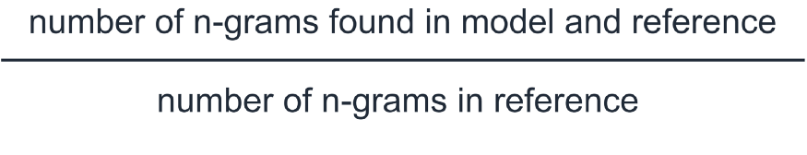
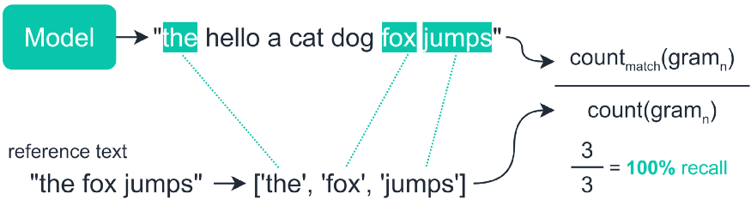
ROUGE recall
Source: https://towardsdatascience.com/the-ultimate-performance-metric-in-nlp-111df6c64460

Slide 40
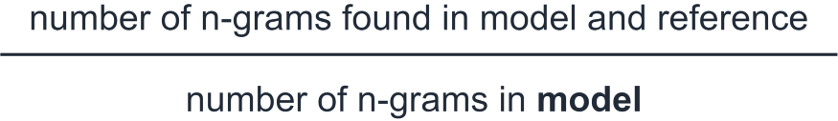

ROUGE precision
Source: https://towardsdatascience.com/the-ultimate-performance-metric-in-nlp-111df6c64460

Slide 41

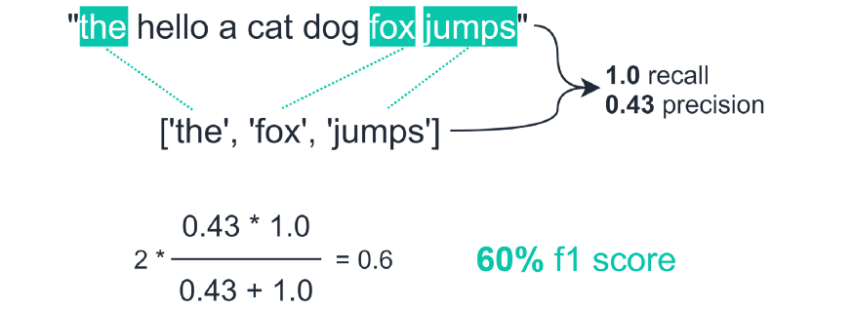
ROUGE f-score
Source: https://towardsdatascience.com/the-ultimate-performance-metric-in-nlp-111df6c64460

Slide 42
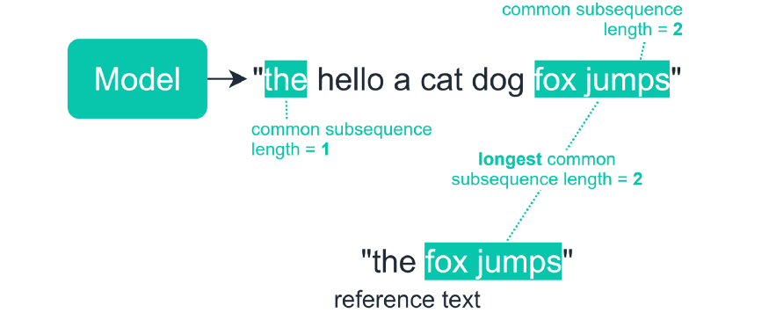
ROUGE-L
Source: https://towardsdatascience.com/the-ultimate-performance-metric-in-nlp-111df6c64460

Slide 43
BLEU vs. ROUGE
Bleu measures precision: how much the words (and/or n-grams) in the machine generated summaries appeared in the human reference summaries.
Rouge measures recall: how much the words (and/or n-grams) in the human reference summaries appeared in the machine generated summaries.
Naturally - these results are complementing, as is often the case in precision vs recall. If you have many words from the system results appearing in the human references you will have high Bleu, and if you have many words from the human references appearing in the system results you will have high Rouge.
In your case it would appear that sys1 has a higher Rouge than sys2 since the results in sys1 consistently had more words from the human references appear in them than the results from sys2. However, since your Bleu score showed that sys1 has lower recall than sys2, this would suggest that not so many words from your sys1 results appeared in the human references, in respect to sys2.
This could happen for example if your sys1 is outputting results which contain words from the references (upping the Rouge), but also many words which the references didn't include (lowering the Bleu). sys2, as it seems, is giving results for which most words outputted do appear in the human references (upping the Blue), but also missing many words from its results which do appear in the human references.

Slide 44
BLEU vs. ROUGE
BTW, there's something called brevity penalty, which is quite important and has already been added to standard Bleu implementations. It penalizes system results which are shorter than the general length of a reference (read more about it here). This complements the n-gram metric behavior which in effect penalizes longer than reference results, since the denominator grows the longer the system result is.
You could also implement something similar for Rouge, but this time penalizing system results which are longer than the general reference length, which would otherwise enable them to obtain artificially higher Rouge scores (since the longer the result, the higher the chance you would hit some word appearing in the references). In Rouge we divide by the length of the human references, so we would need an additional penalty for longer system results which could artificially raise their Rouge score.
Finally, you could use the F1 measure to make the metrics work together: F1 = 2 * (Bleu * Rouge) / (Bleu + Rouge)

Slide 45

Evaluation

Slide 46
Evaluation
To do an effective benchmarking we must evaluate different models using unseen data.
We chose the WikiHow Arabic dataset to benchmark our models

Slide 47
Evaluation
Model | ROUGE-L (recall) | ROUGE-L (precision) | ROUGE-L (f score)
Mt5_vanilla | 0.073980 | 0.152992 | 0.093670
Mt5_fineTuned | 0.117180 | 0.099786 | 0.095431
Extractive | 0.220663 | 0.112450 | 0.139355
TextRank | 0.220663 | 0.112450 | 0.139355

Slide 48
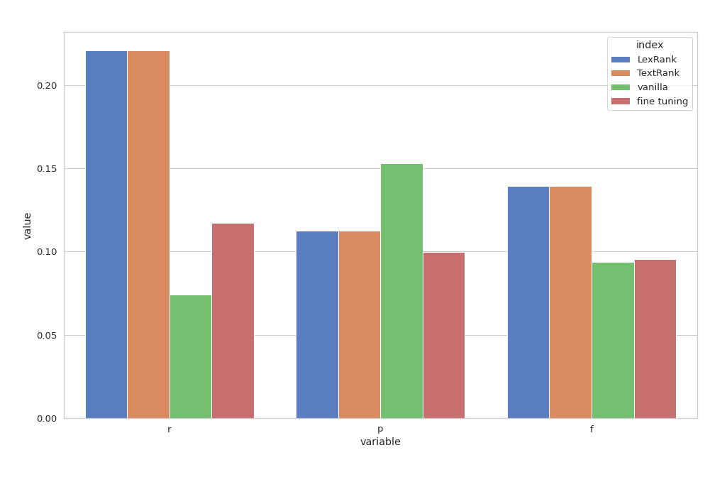
Evaluation

Slide 49
Evaluation
 | Extractive (Lex & Test Based) | Machine Learning
Needs training | No | Yes
Inference time | Fast | Slower
Output Length | Tunable | Fixed
Output shape | Part of original | Generated
Summarization Type | Extractive | Abstractive
Coherence of output | Low | Higher

Slide 50
Note on ROUGE
Optimizing the ROUGE score does not capture synonyms and related words that have the same meaning.
ROUGE does not cater for different words that have the same meaning — as it measures syntactical matches rather than semantics.

Slide 51

Limitations

Slide 52
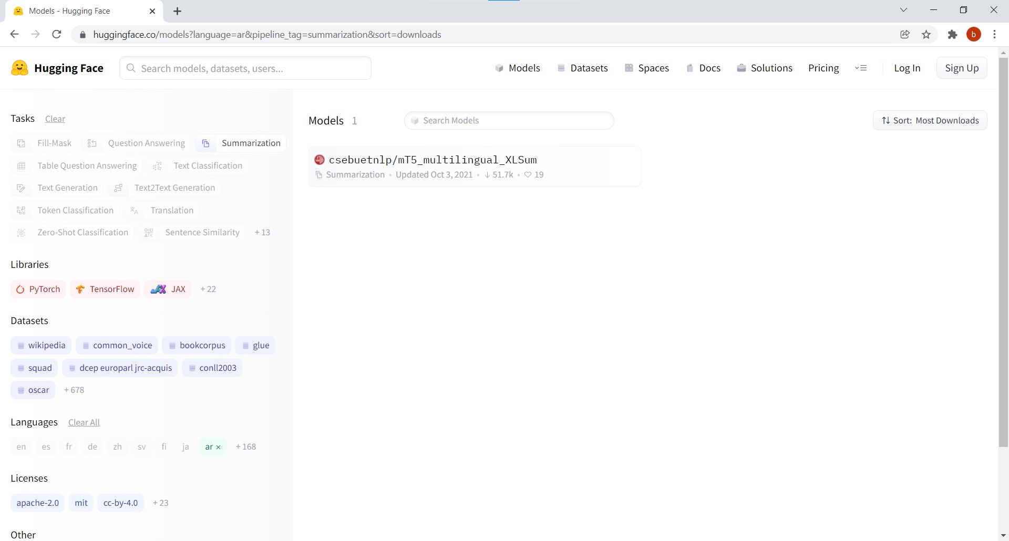
Limitations
Only one model on Huggingface that supports Arabic text summarization.

Slide 53
Limitations
Arabic datasets are limited (most datasets can suit for fine tuning not to train a DL model from scratch)

Slide 54

Limitations
GPU!

Slide 55

Demo

